Slide 1
Bertolt Brecht
By Anna and Chantel

Slide 2
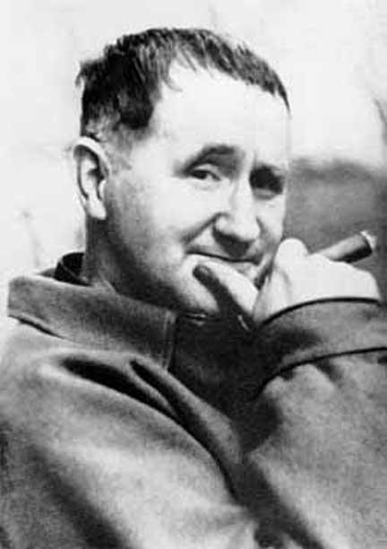
Background
Born on the February 10 1898 (Augsburg, Germany)
Died on August 14 1956 (Berlin)
Had three wives

Slide 3
Brecht’s Career (1933)
Brecht's political and satirical writing made him an early enemy of the National Socialists
Many of his plays and poems were burned
Made alliances with translators
Spent most of his time writing other plays and poems

Slide 4
Brecht’s Major Plays
The Threepenny Opera (1954)
The Caucasian Chalk Circle (1944)
Mother Courage (1941)
Most were written in Germany however a number of plays and poems were written during his travels to Czech Republic, Switzerland, France, Denmark, Sweden and Finland

Slide 5
Erwin Piscator
First World War, mass industrialisation, capitalist ideology
Epic theatre - didactic
Interrupts the story line to address the audience directly with analysis

Slide 6
Didactic Drama
A message was always portrayed, not simply entertainment
Social issues e.g. Nazis, communism, social ranks, Marxism
Recognise the ills of the capitalist society
Aims to educate the audience

Slide 7
EPIC THEATRE
“replaced the illusion of conventional ‘dramatic’ theatre”
uses a montage of scenes to expose the social dynamics of the action
alienation
Limit empathy and critical appraisal of the plays

Slide 8
Alienation-effect
Verfremdung
Elimination of conventional stage props
Charts, slides, messages
Breaking the fourth wall
Intentional incongruities

Slide 9
Brecht's Epic Theatre Techniques
Actors do not identify with characters
Break the fourth wall
Clear choices

Slide 10
Staging Techniques
Placards
Minimalist props
Costume changes
Lighting
Music

Slide 11
So what is non-naturalistic theatre?
Intentionally does not replicate a real-life situation
Aims to break out of what an audience would consider realistic

Slide 12
Sources
http://www.encyclopedia.com/topic/Bertolt_Brecht.aspxwww.rhinegold.co.uk/downloads/catalogue_supporting.../Brecht.ppt http://www.slideshare.net/ghalcrow/brechtian-theatre http://www.brechtsociety.org
Bertolt Brecht - Meg Mumford (p. 28-29)
The Cambridge Guide To Theatre - Martin Banham (p 129) Twentieth Century Theatre - Colin Chambers (p 105 - 109)

